Slide 1
Board of Directors
Governance Committee:
Risk Subcommittee
Paul Skinner
Agenda Item: Enterprise Risk Management
February 22, 2021

Slide 2
CRB Enterprise Risk Subcommittee Charter
Provide governance for risk activities and functions for the organization
Identify emerging and strategic risks in the business
Evaluate the effectiveness of existing risk management procedures and practices
Recommend and report on risk mitigating strategies
2

Slide 3
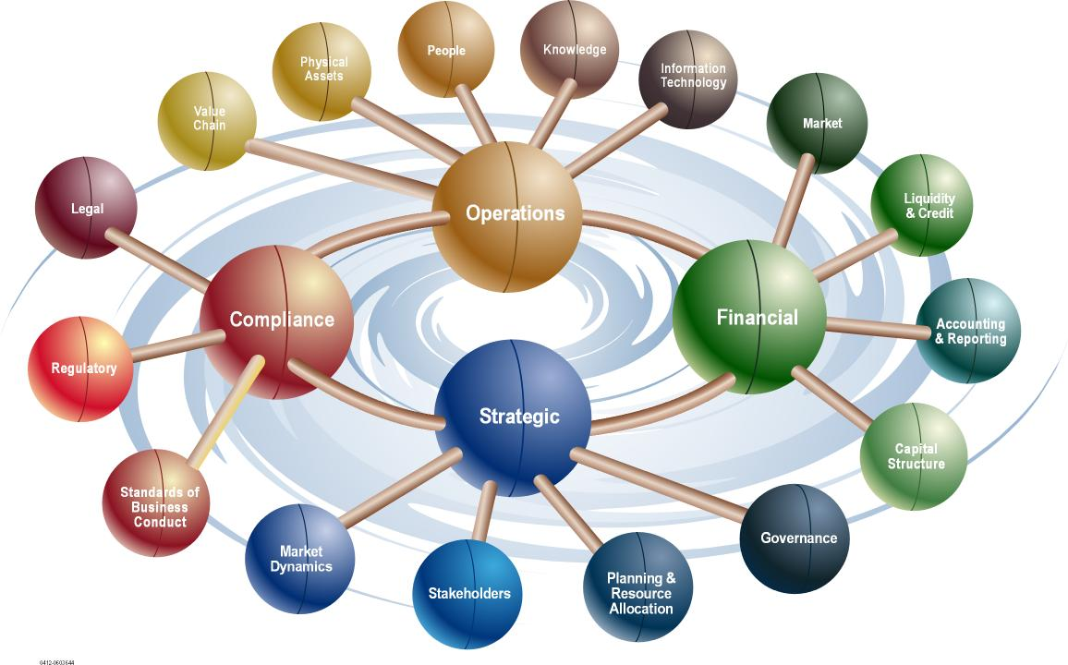
ERM Program Vision
Assess current risk practices to provide a roadmap for ERM
EPIC (owner of Greyling) associated with FMI selected as partner to help develop CRB’s ERM program
$200K contract awarded
Assessment report due by May 2021 BOD
Results based on a robust
company survey and selected
interviews among several functions
3

Slide 4
EPIC Program Drivers for ERM
1
Instil a culture where risk management and risk ownership are being practiced as the responsibility of every employee.
2
Create an appropriate awareness and understanding of risks throughout the organization to enable risks to be engaged in an informed manner.
3
Proactively identify and appropriately manage risks within the risk appetite of the organization.
4
5
Embed risk management in the way the organization is managed and the way in which it operates, and
Direct compliance with the appropriate risk management practices as required in terms of corporate governance guidelines.
4

Slide 5
CRB Team Priorities for EPIC
Focus on ERM holistically, shift from “don’t get in trouble on a project” to a robust and strategic risk management methodology
Management of the risk for international expansion
An integrated approach to design-build
Comprehensive risk management practices to allow for growth
Retention of the entrepreneurial culture of the organization
D&O - personal and uninsured liability risk management
Supply chain risk and what risk management strategies can be implemented
Subcontractor default
Project portfolio makeup
A balance between engineering and construction disciplines
5

Slide 6
Project Timeline
Tasks | 2/12 | 2/19 | 2/26 | 3/5 | 3/12 | 3/19 | 3/26 | 4/2 | 4/9 | 4/16 | 4/23 | 4/30 | 5/7 | 5/14 | June
Planning (PMO)
i. ERM Survey
II. Internal Risk Assesssment
1) Human Resources
2) IT
3) EHS
4) Project Operations
5) Business Continuity
6) Financial
7) Compliance & Reputation
8) Strategic & Financial
9) Economic
10) Technological
11) Social & Cultural
12) Political / Soverign
13) Environmental
14) Legal
III. Report Out
Start
2/8 – 2/12
Note:
Weekly program
updates provided
Project on track (surveys released and in progress)
HIGH
2/15– 2/19
2/22/21 – 3/24/23
2/22 – 2/24
2/25 – 3/2
3/3 – 3/5
3/8 – 3/12
Operational Risks
3/15 – 3/16
3/17 – 3/19
Information for
Decision-making
Risks
3/22 – 3/24
3/29 – 3/31
4/1 – 4/2
4/5 – 4/7
4/8 – 4/9
External Risks
4/12 - 4/14
4/15 – 4/16
4/19 – 4/21
Report out
5/14
4/26 – 5/7
BOD 5/24/21
6
Current

Slide 7
ERM Steering Committee
Jesse Adams
Can Aktar
Robert Brady
Danielle David
Sue Dreckman
Derrick Green
Courtney Holt
Chris Humphrey
John Linsley
Jim Scott
Bart Schubert
Russ Sheppard
Paul Skinner
7

Slide 8
Questions

